Slide 1
Keelings
By Holly Lavin 01/04/2020

Slide 2
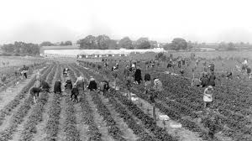
How keeling's began
Keelings was founded in 1926 in Dublin
The first place they sold their food was in the Dublin market in the 1930s
In the 1970s they grew in size and added new products to supply the new growing supermarket industry
In the 2000s Keelings introduced new supply chain methods to ensure the customers get the product in time and as fresh as possible
This is it’s ninety third year in business

Slide 3
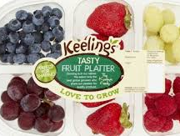
What they grow
1920-1916 rhubarb was the main crop
1937 was the first time Keelings grew strawberries
1949 Keelings started to grow brambly apples
Today they grow lots of different fruit such as, apples, pears, blackberries, cheeries, raspberries and blueberries

Slide 4
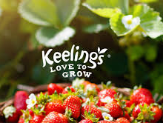
Keelings facts
Over 2,000 people work for Keelings
Keeling's saying is “Keelings Love To Grow”
They want kids and adults to grow more plants
Keeling’s home shop sell honey and pineapple as well as berries

